Slide 1



Part 1
By: Omer Ben-Naim, Maya Saghiv

Slide 2

Agenda
Project Overview – Dataset & Goal
Dataset Preparation & Preprocessing
Filtering & Cleaning
Extracting Valuable Data
Plan of Attack
Filters
Methods
Techniques
Performance Measures
Challenges
Notes:
Project overview:
Project description
Project goal
Dataset overview:
Background
Datasets show – printscreen of 3 datasets – data, user, movies
Plan of attack:
Preperation & preprocessing
Descriptive statistics (users, movies & rates)
Methods – collaborative, content
Models - ….
Performance measures
*challenges

Slide 3
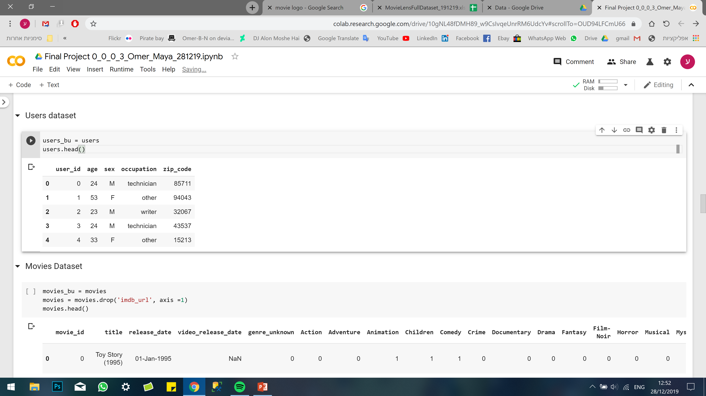
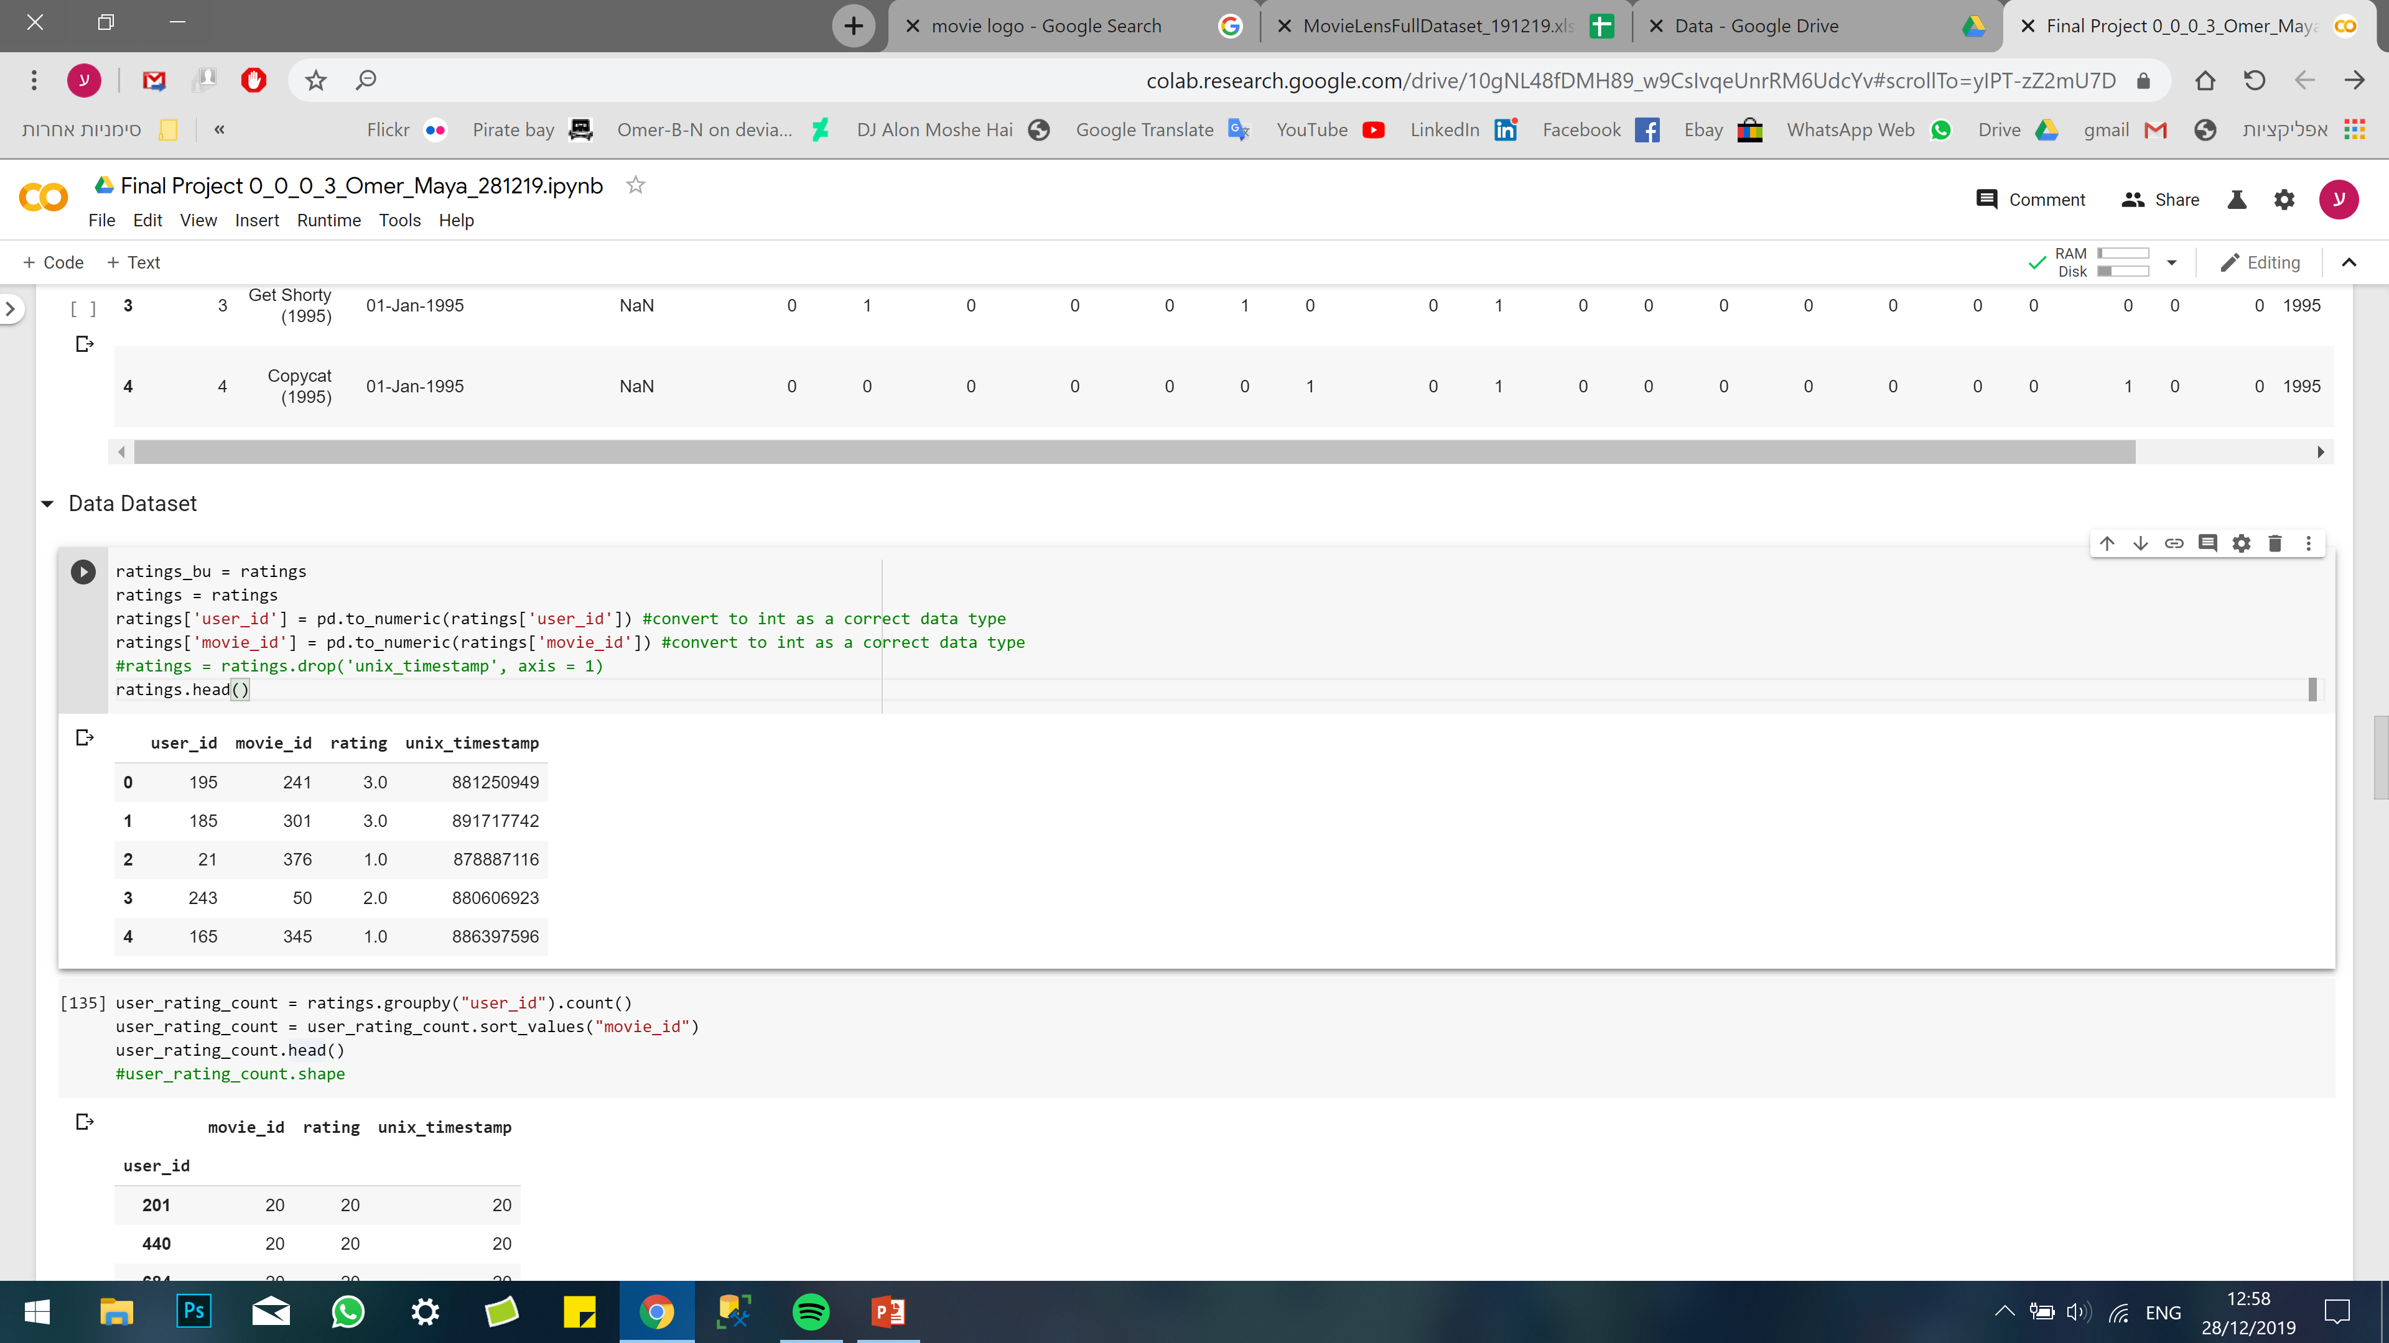
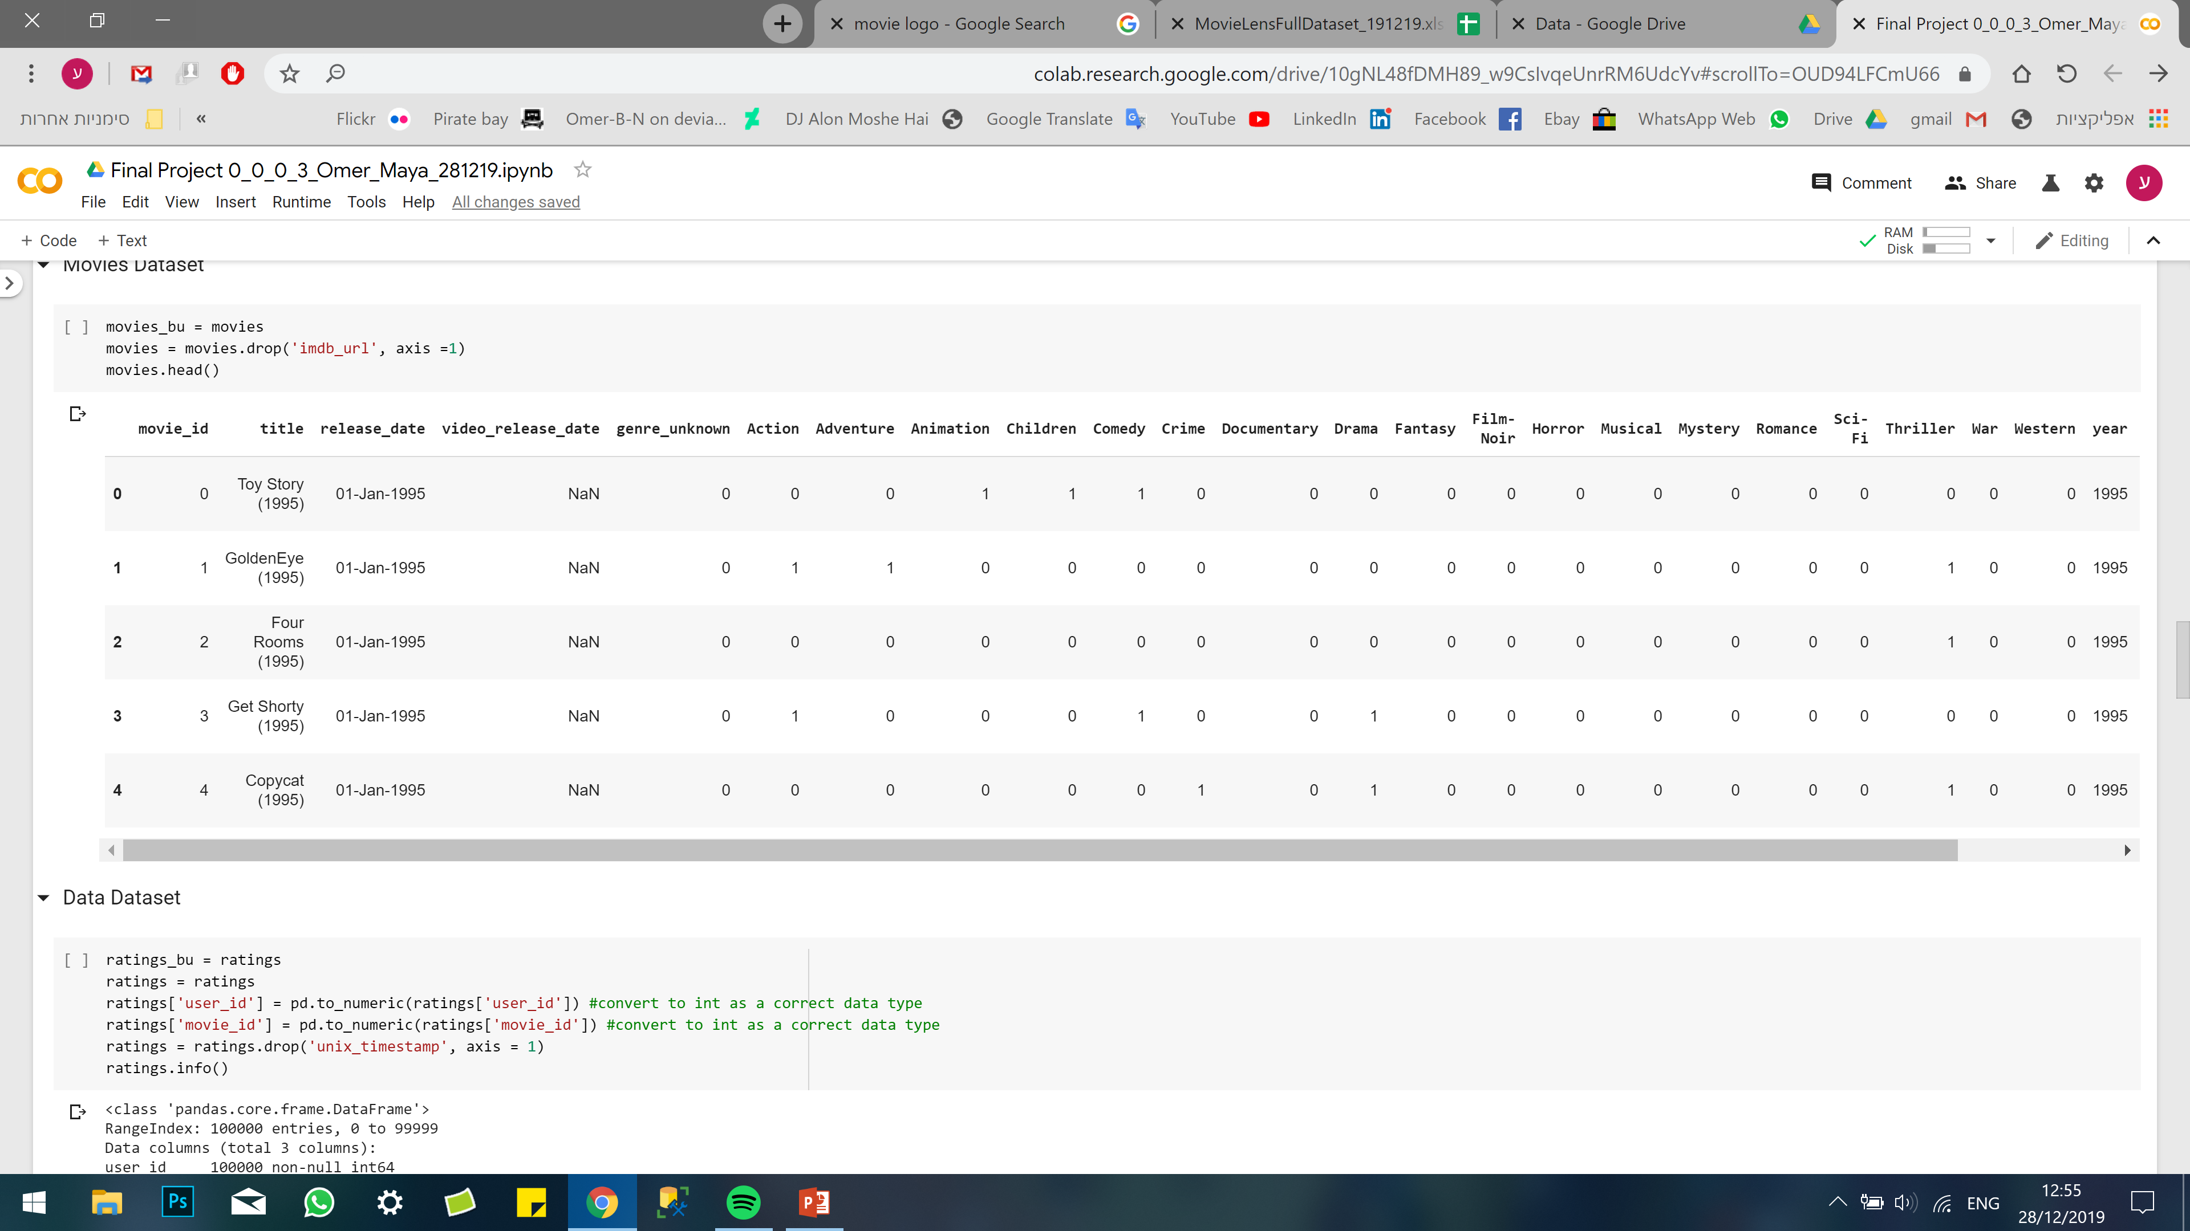
Overview – Datasets
3 datasets:
Users:
Ratings:
943
100,000
Movies:
1,682
Notes:
OMER

Slide 4


Overview – Goal
Classifying the problem:
Recommendation system
Goal:
Recommend the 10 most relevant movies to each user
Notes:
OMER

Slide 5
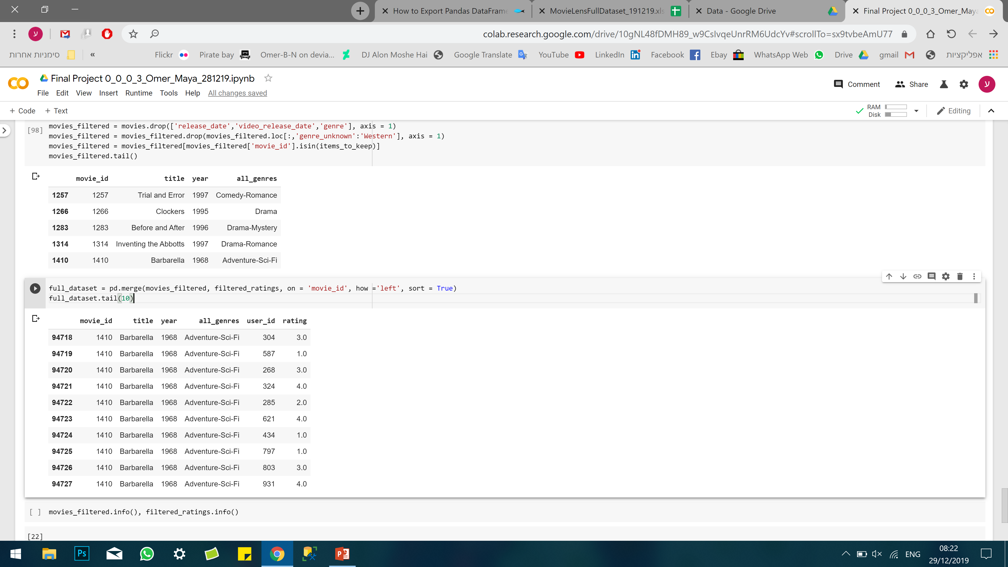
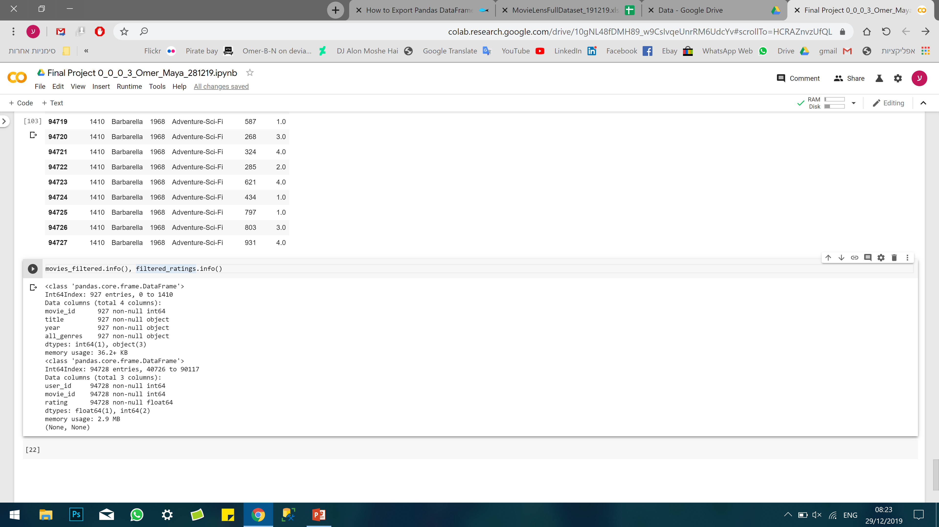
Preparation and preprocessing Filtering & Cleaning
Unite to one dataset:
‘Movies’ dataset to ‘Ratings’
Remove “one-hot encoded” like genres
Extract movie year from movie title
Replace movie id with movie title
We decided to not use the Users data, for now..
Dataset preparation:
No NA’s where found, and all the users rated at 20 movies at least.
Created metadata column of genres and
Notes:
OMER

Slide 6

Preparation and preprocessing Extracting Valuable Data (1)
Ratings
Ratings – Key to:
1. Goal Prediction
2. Identify Similar Users
Users
Movies
Notes:
MAYA

Slide 7
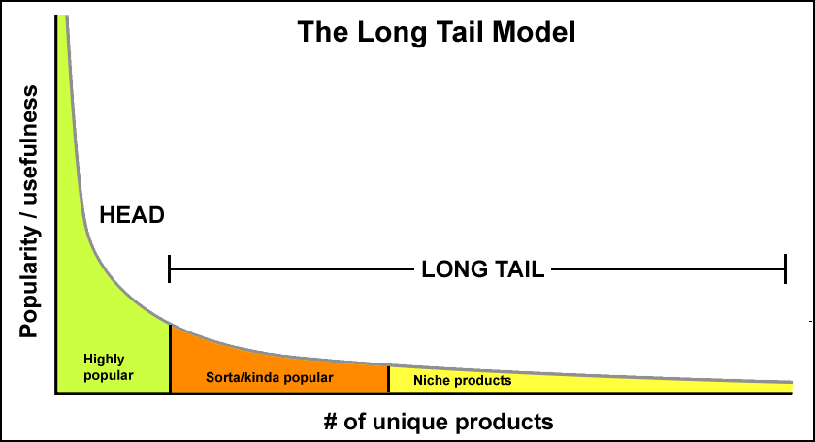
The Long Tail
Popularity / Usefulness vs. Unique Products
Notes:
OMER

Slide 8
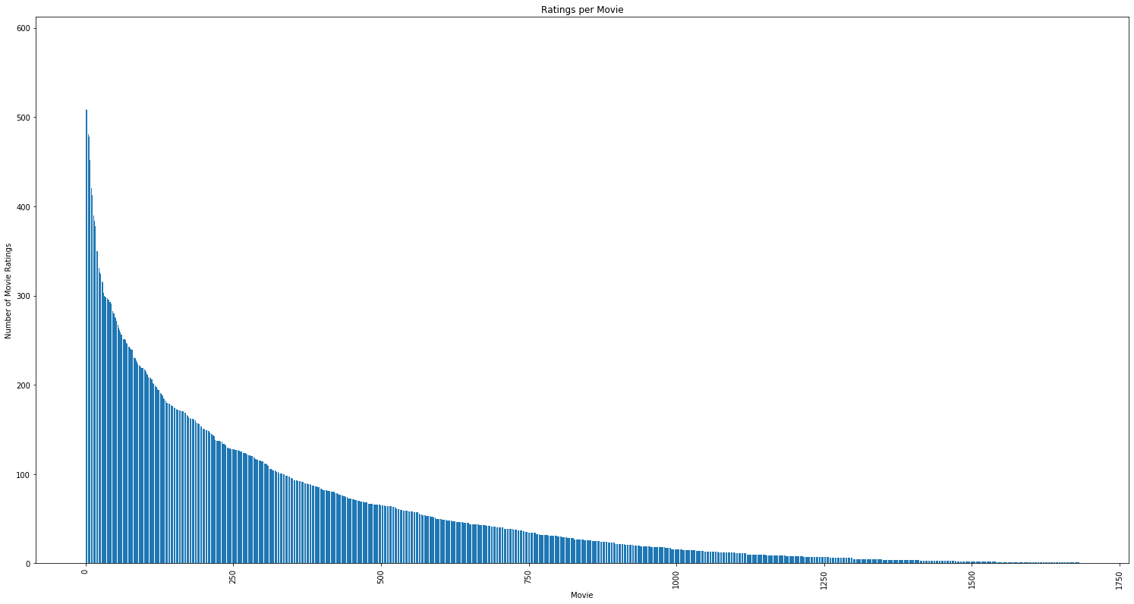
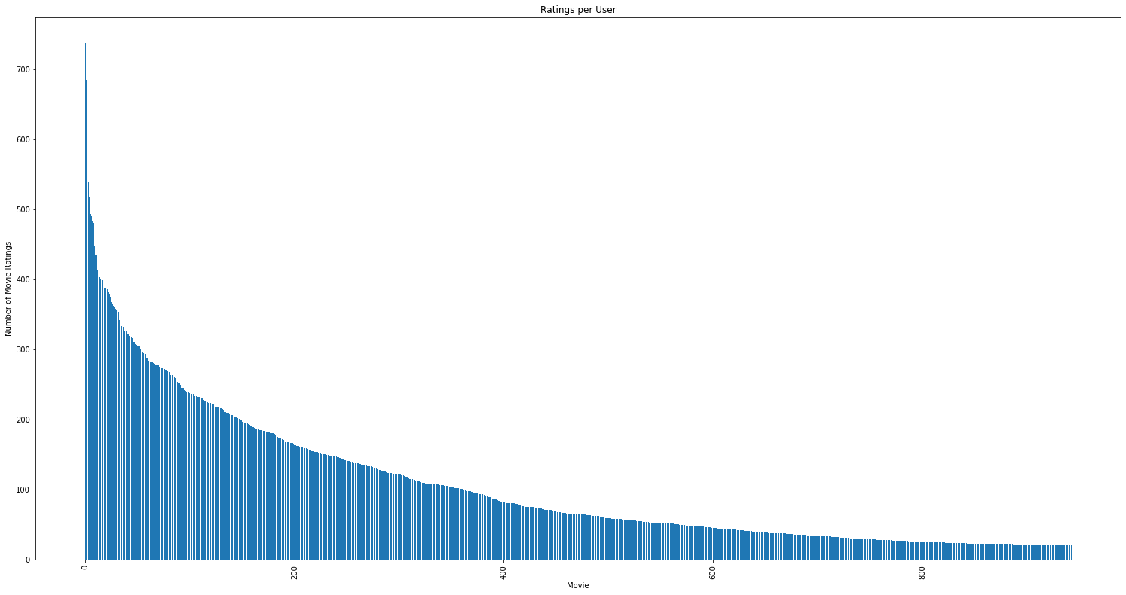


Preparation and preprocessing Extracting Valuable Data (2)
Ratings per MOVIE
Ratings per USER
Ratings
Ratings
Movies
Users
Notes:
MAYA

Slide 9

Preparation and preprocessing Extracting Valuable Data (3)
Ratings
‘Valuable’ Data Trade-Offs:
Representative Movies vs. Long-Tail Leverage
Users ‘to keep’ vs. Niche Movies
Users
Movies
Notes:
MAYA

Slide 10
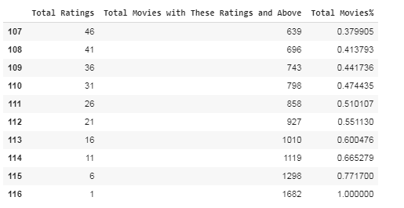
Preparation and preprocessing Extracting Valuable Data (4)
Frequency Table –
Total Ratings vs. Total Movies with This Rating and Above
Notes:
MAYA

Slide 11
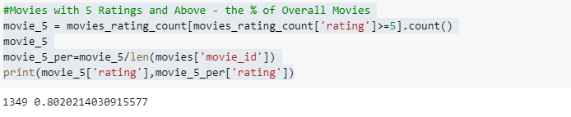
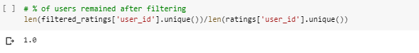
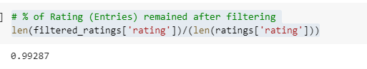
Preparation and preprocessing Extracting Valuable Data (5)
Rating >=5
1349 Movies, 80.2%
100% Users
99.3% Ratings
Notes:
MAYA

Slide 12
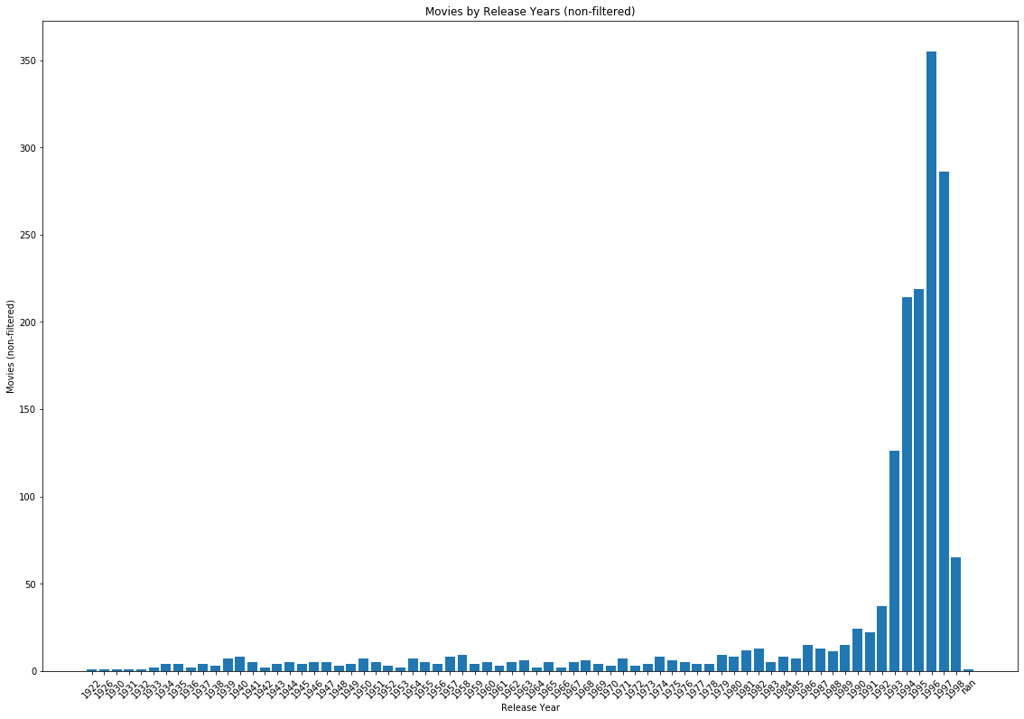
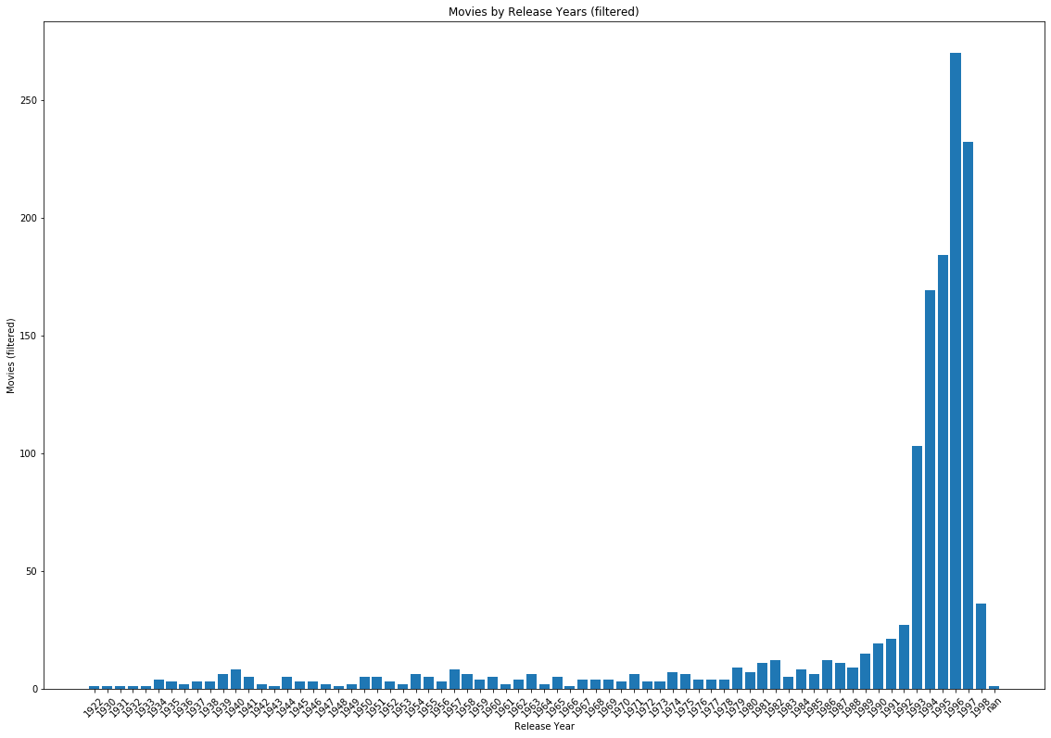
Preparation and preprocessing Extracting Valuable Data (6)
Extraction Impact (1) – Movies by Release Years:
Non-Filtered
Filtered
Movies
1993
1993
1998
1998
Release Year
Notes:
MAYA

Slide 13
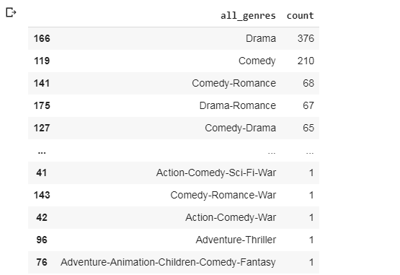
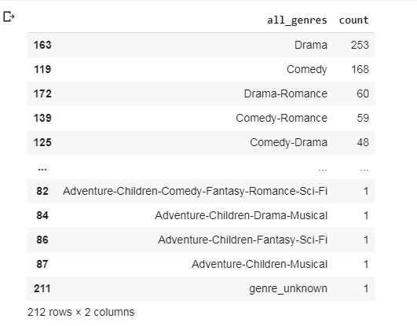
Preparation and preprocessing Extracting Valuable Data (7)
Extraction Impact (2) – Movies by Genres:
Non-Filtered
Filtered
Notes:
MAYA

Slide 14
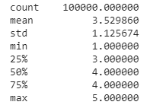
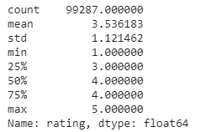
Preparation and preprocessing Extracting Valuable Data (8)
Extraction Impact (3) – Ratings:
Non-Filtered
Filtered
Notes:
MAYA

Slide 15
Preparation and preprocessing Extracting Valuable Data (9)
Ratings per Movie – ‘Valuable Data’ Baseline
Ratings
Movies with Ratings 5 and above:
80.2% of the Movies
100% of the Users
99.3% of the Ratings
5
Movies
Notes:
MAYA

Slide 16
“Plan of Attack”
Notes:
OMER

Slide 17
Recommender Systems
User content filtering vs. Item content filtering
User content filtering:
Age
Gender
Occupation
Country
Item content filtering:
Genre
Cast and crew names
Movies reviews and rating

Slide 18
Recommender Systems
Memory based vs. Model based technique
Memory based:
Create a matrix of similarities that can help predict the result.
Real-time learning
Tf-idf, similarity, clustering, Knn..
Model based:
Learn preferences based on machine learning models
Off-line learning
PCA, SVD, Neural nets., Bayesian networks..

Slide 19
Recommender Systems
Collaborative vs. Content base Recommender Method
Collaborative:
“Tell me what popular among my peers”
Based on “Hard” data – match what I liked and what my peers liked and give me items based on similar peers ratings
Content base:
“Show me more of the same what I’ve liked”
Based on “Soft” data – find what I liked based on my ratings and give me items based on the content

Slide 20
Recommender Systems
Filter
Technique
Method
DATA
User Content filtering
Item Content filtering
Memory Based
Model Based
Memory Based
Model Based
Content Based
Collaborative
Content Based
Collaborative
Content Based
Collaborative
Content Based
Collaborative
(Age, Gender, Occupation, Country)
(Genre, Cast, Keywords)

Slide 21
Next steps:
Similarity:
Cosine similarity / Pearson Correlation
Evaluation Metrics:
MAE / RMSE / Recall@K & Percision@K

Slide 22

Challenges
Where to start??
‘Valuable’ Identification- Long Tail Items vs. Sufficient Ratings Trade-off
Performance Measures
Notes:
OMER

Slide 23

Thank You

